Slide 1
IHEP SUSY Group Meeting
Chengxin Liao
Institute of High Energy Physics Chinese Academy of Sciences Jul 23, 2025

Slide 2
C1N2 Status
Split run2 and run3 then Update Bkg estimation(Done)
Update support-note(Ongoing) Note: lowerpad for MC modeling label have typo(bkg/MC, it should be bkg/Data)

Slide 3
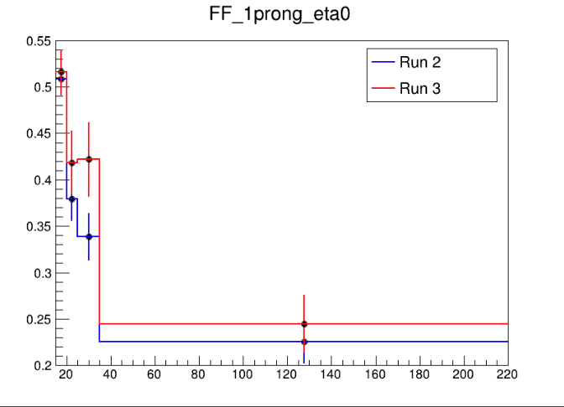
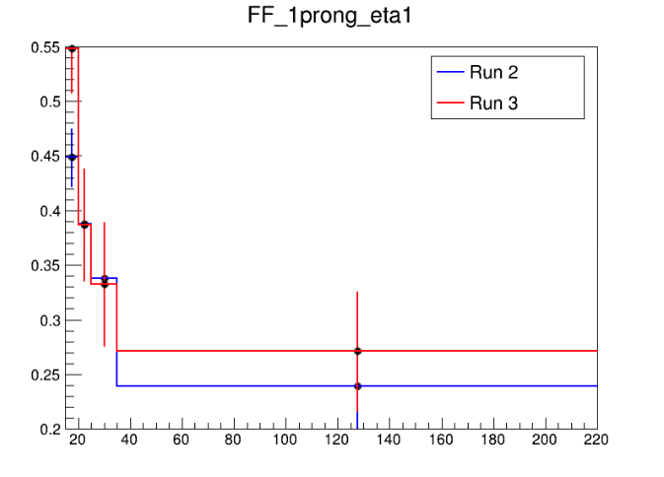
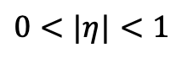
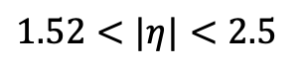
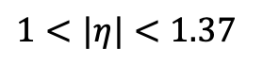
Fake Factor for Run2 and Run3
$0<|η|<1$
$1<|η|<1.37$
$1.52<|η|<2.5$
Selection:
nBaseTau == 1
nBaseLep >= 1, SigLep >= 1 MET trigger, MET >= 200
Same-Signal(Orthogonal with SR) bVeto ID: nMediumTau == 1 antiID: nMediumTau < 1
A small bump show in the last bin

Slide 4
Pre-Selection
HH Pre-selection
>= 2 medium taus
0 base lepton
MET ≥ 200; pass MET trigger
1≤nJet
Opposite-sign hadronic-hadronic tau pair
bveto
jet pt>100 GeV
Mtt_reco <= 40 GeV || Mtt_reco >= 130GeV
LH Pre-selection
>= 1 medium taus
1 base lepton, 1 signal lepton
MET ≥ 200; pass MET trigger
1≤nJet
Opposite-sign lepton-hadronic tau pair
bveto
jet pt>100 GeV
Mtt_reco <= 40 GeV || Mtt_reco >= 130GeV

Slide 5
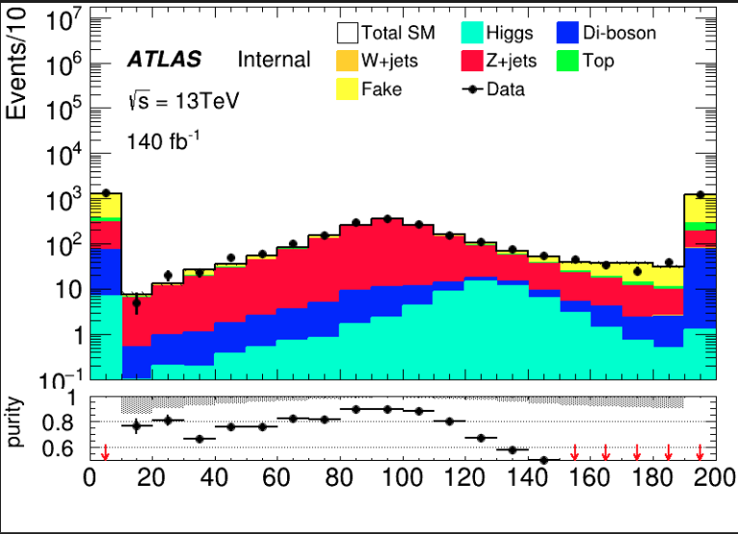
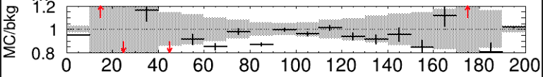
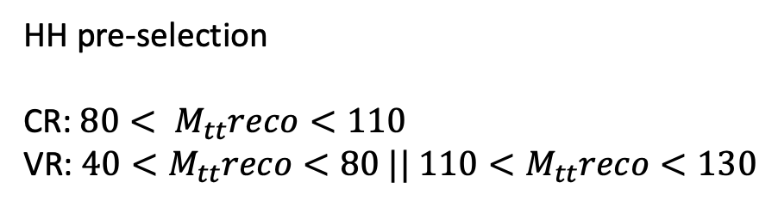
HH channel: Z bkg estimation(run2)
HH pre-selection CR: $80< M_{tt}reco<110$ VR: $40<M_{tt}reco<80 || 110<M_{tt}reco<130$
Region | TotalBkg | Zjets | purity | Data | Data/Bkg
CR | 1041+-9 | 915+-4 | 0.87 | 1090 | 1.04
VR1(left) | 587+-7 | 496+-3 | 0.84 | 663 | 1.12
VR2(right) | 334+-6 | 238+-2 | 0.71 | 346 | 1.03

Slide 6
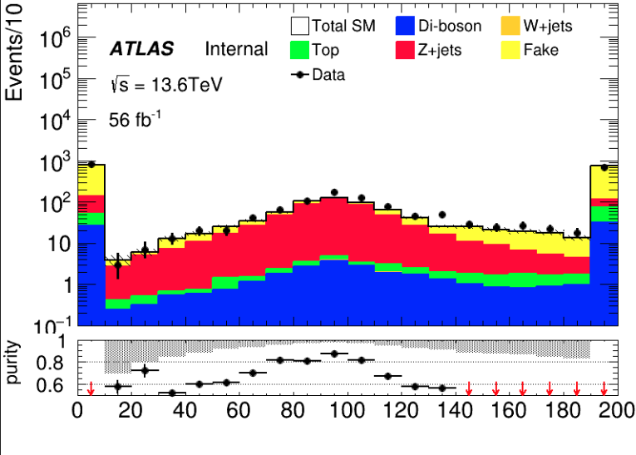
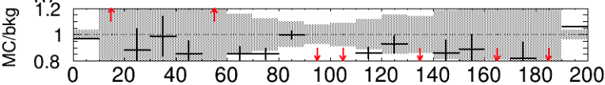
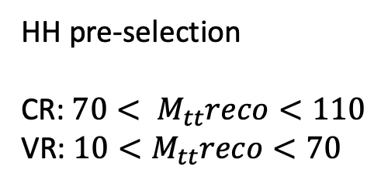
HH channel: Z bkg estimation(run3)
HH pre-selection CR: $70< M_{tt}reco<110$ VR: $10<M_{tt}reco<70$
After meeting
Regionc | TotalBkg | Zjets | purity | Data | Data/Bkg
CR | 396+-7 | 320+-2 | 0.81 | 482 | 1.21
VR1(left) | 238+-6 | 181+-2 | 0.75 | 252 | 1.05
VR2(right) | 132+-5 | 82+-1 | 0.62 | 171 | 1.29

Slide 7
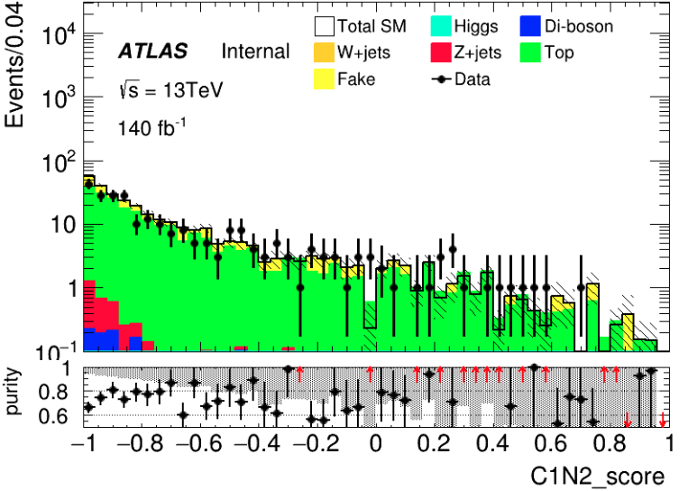
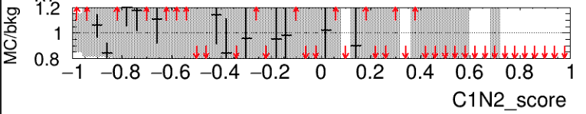
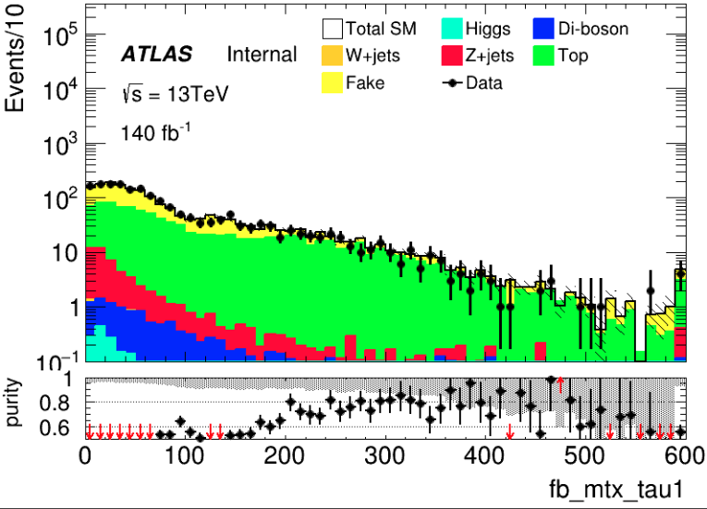
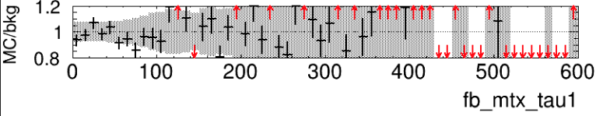
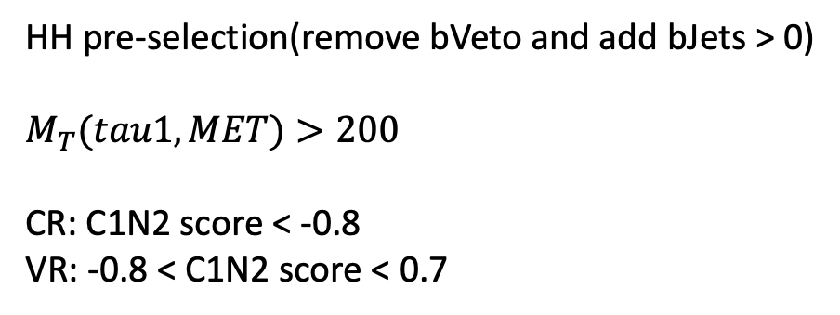
HH channel: Top bkg estimation(run2)
HH pre-selection(remove bVeto and add bJets > 0)
$$M_{T}(tau1, MET)>200$$
CR: C1N2 score < -0.8 VR: -0.8 < C1N2 score < 0.7
Region | TotalBkg | Top | purity | Data | Data/Bkg
CR | 168+-6 | 123+-4 | 0.73 | 137 | 0.81
VR | 131+-6 | 103+-3 | 0.78 | 120 | 0.91
Notes:
Top_CR: 123.241, Error: 4.22913
Top_VR: 103.166, Error: 3.89985
, MC_CR: 168.225, Error: 6.00345
, MC_VR: 131.66, Error: 5.39455
, purity_CR: 0.732596
, purity_VR: 0.783579
Data_CR:137
Data_VR:120, SF:0.817986

Slide 8
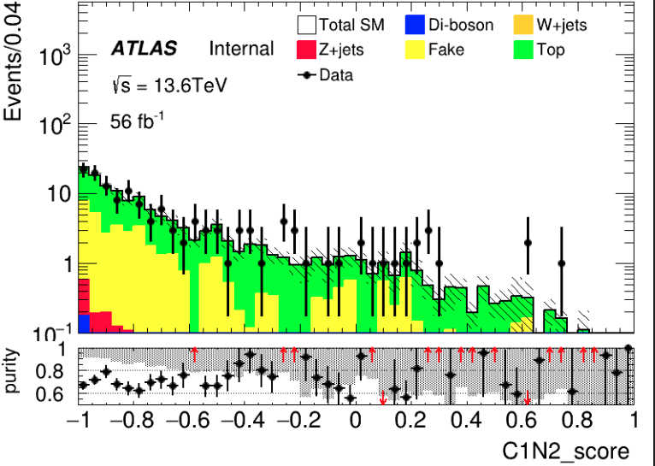
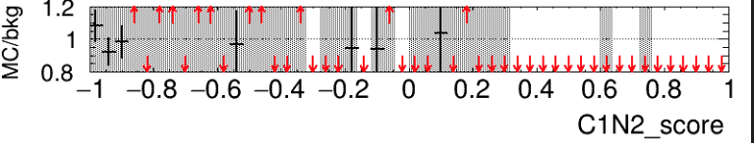
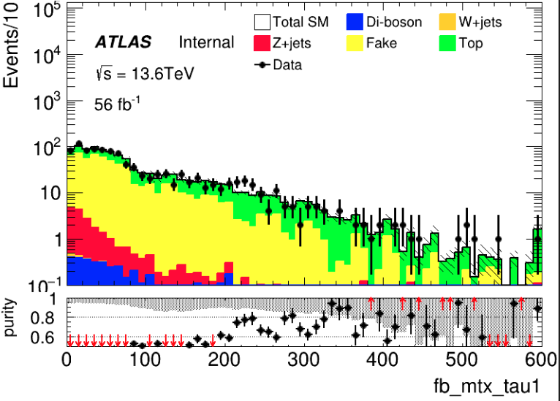
HH channel: Top bkg estimation(run3)
HH pre-selection(remove bVeto and add bJets > 0)
$$M_{T}(tau1, MET)>200$$
CR: C1N2 score < -0.8 VR: -0.8 < C1N2 score < 0.7
Remove upper cut
Region | TotalBkg | Top | purity | Data | Data/Bkg
CR | 73+-3 | 51+-1 | 0.70 | 74 | 1.01
VR | 69+-3 | 51+-1 | 0.73 | 75 | 1.08
Notes:
Top_CR: 51.8364, Error: 1.45582
Top_VR: 51.0968, Error: 1.49776
, MC_CR: 73.8882, Error: 3.49632
, MC_VR: 69.4798, Error: 3.10636
, purity_CR: 0.701553
, purity_VR: 0.73542
Data_CR:74
Data_VR:75, SF:1.03281

Slide 9
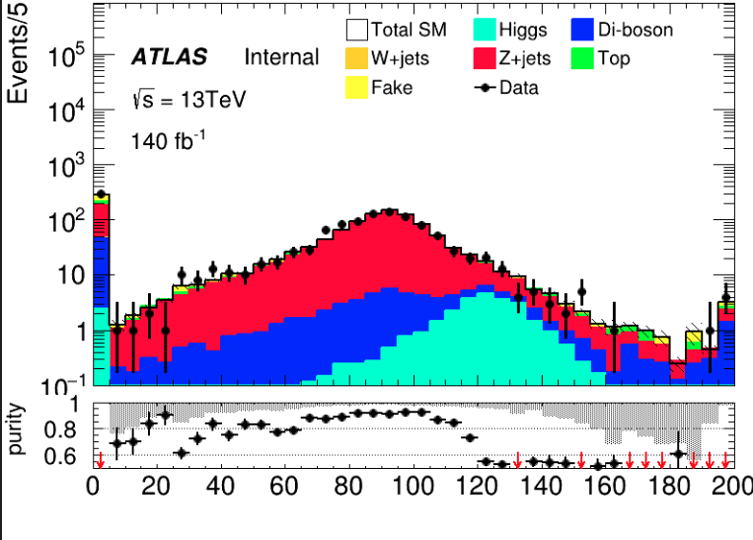
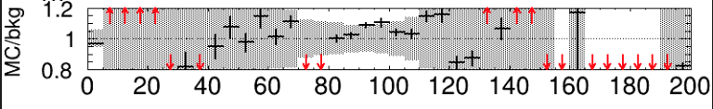
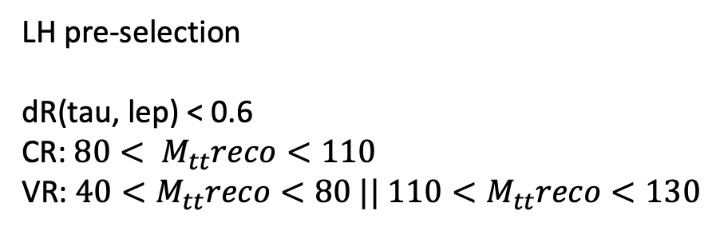
LH channel: Z bkg estimation(run2)
LH pre-selection
dR(tau, lep) < 0.6 CR: $80< M_{tt}reco<110$ VR: $40<M_{tt}reco<80 || 110<M_{tt}reco<130$
Region | TotalBkg | Zjets | purity | Data | Data/Bkg
CR | 660+-6 | 602+-3 | 0.91 | 625 | 0.94
VR1(left) | 316+-4 | 275+-2 | 0.87 | 349 | 1.10
VR2(right) | 92+-2 | 62+-1 | 0.67 | 85 | 0.92
Same selection with HH channel
Notes:
Zjets_CR: 602.218, Error: 3.57613
Zjets_VR1: 275.731, Error: 2.43721
Zjets_VR2: 62.982, Error: 1.07491
, MC_CR: 660.681, Error: 5.86854
, MC_VR1: 316.96, Error: 4.18877
, MC_VR2: 92.6616, Error: 1.94987
, purity_CR: 0.911511
, purity_VR1: 0.869922
, purity_VR2: 0.679699 Data_CR:625Data_VR1:349Data_VR2:85

Slide 10
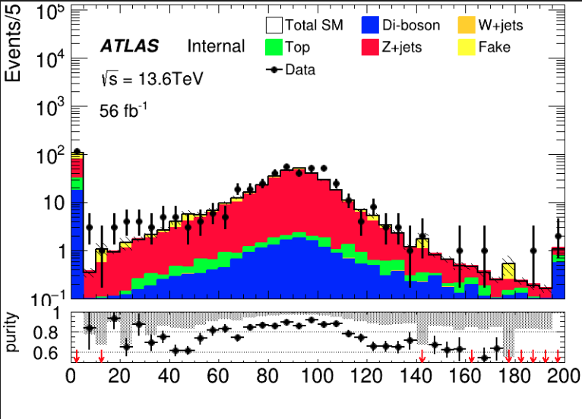
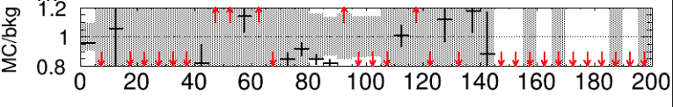
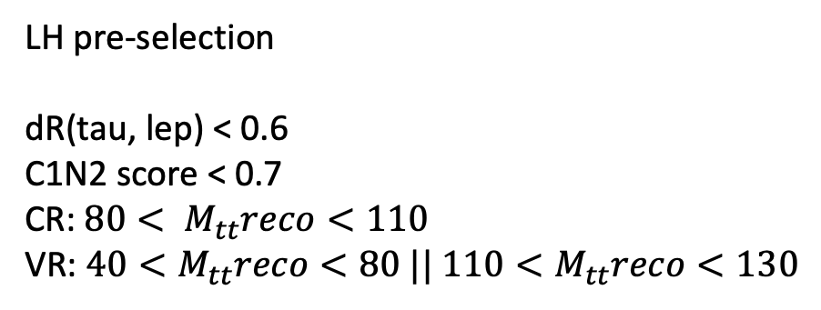
LH channel: Z bkg estimation(run3)
LH pre-selection
dR(tau, lep) < 0.6 C1N2 score < 0.7 CR: $80< M_{tt}reco<110$ VR: $40<M_{tt}reco<80 || 110<M_{tt}reco<130$
Region | TotalBkg | Zjets | purity | Data | Data/Bkg
CR | 230+-3 | 202+-2 | 0.87 | 277 | 1.20
VR1(left) | 118+-3 | 96+-1 | 0.81 | 127 | 1.07
VR2(right) | 29+-1 | 21+-1 | 0.72 | 29 | 1.00
MttReco
Notes:
Zjets_CR: 202.29, Error: 1.79532
Zjets_VR1: 96.3843, Error: 1.31294
Zjets_VR2: 21.0604, Error: 0.527863
, MC_CR: 230.559, Error: 3.31619
, MC_VR1: 118.019, Error: 2.82184
, MC_VR2: 29.0431, Error: 1.34237
, purity_CR: 0.877391
, purity_VR1: 0.816687
, purity_VR2: 0.725144
Data_CR:277Data_VR1:127Data_VR2:29

Slide 11
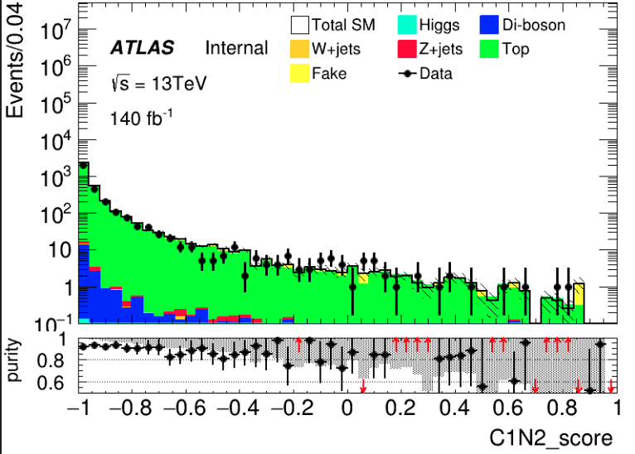
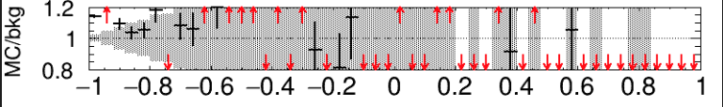
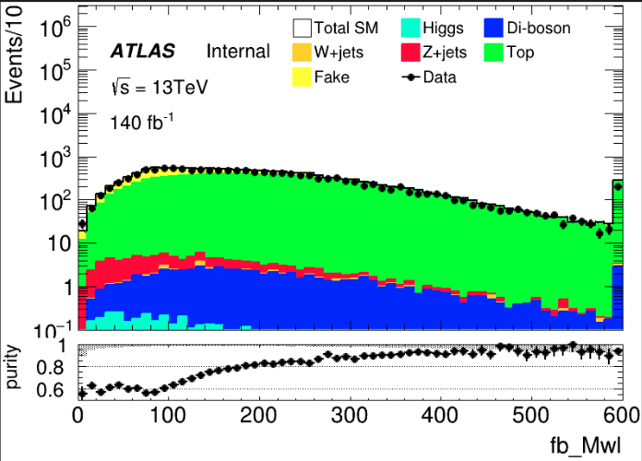
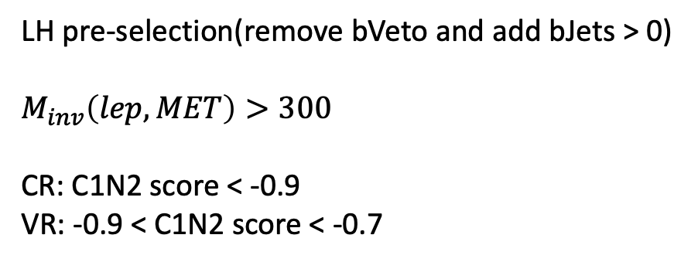
LH channel: Top bkg estimation(run2)
LH pre-selection(remove bVeto and add bJets > 0)
$$M_{inv}\left(lep, MET\right)>300$$
CR: C1N2 score < -0.9 VR: -0.9 < C1N2 score < -0.7
C1N2 score
After pre-selection
Region | TotalBkg | Top | purity | Data | Data/Bkg
CR | 2981+-23 | 2743+-19 | 0.92 | 2593 | 0.86
VR | 619+-10 | 559+-8 | 0.90 | 565 | 0.91
Notes:
../run2/LHTCR_merged_run2/5fold/C1N2_weight/final
Top_CR: 2743.2, Error: 19.9115
Top_VR: 559.551, Error: 8.9529
, MC_CR: 2981.65, Error: 23.4706
, MC_VR: 619.636, Error: 10.6324
, purity_CR: 0.920027
, purity_VR: 0.903032
Data_CR:2593
Data_VR:565, SF:0.864075

Slide 12
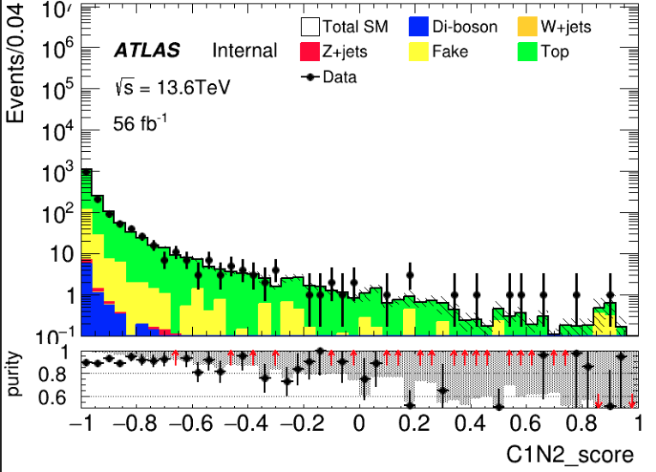
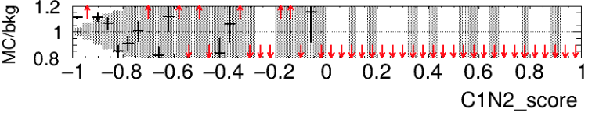
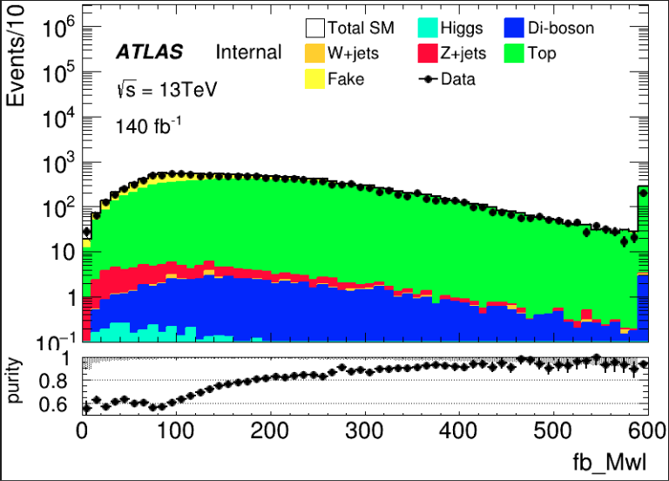
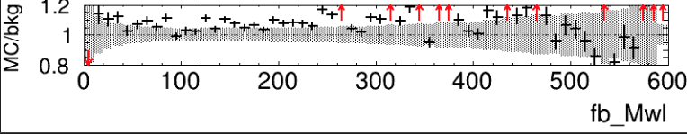
LH channel: Top bkg estimation(run3)
LH pre-selection(remove bVeto and add bJets > 0)
$$M_{inv}\left(lep, MET\right)>300$$
CR: C1N2 score < -0.9 VR: -0.9 < C1N2 score < -0.7
Region | TotalBkg | Top | purity | Data | Data/Bkg
CR | 1446+-11 | 1295+-7 | 0.89 | 1278 | 0.88
VR | 314+-5 | 288+-3 | 0.91 | 298 | 0.94
Notes:
Top_CR: 1295.59, Error: 7.50495
Top_VR: 288.832, Error: 3.70686
, MC_CR: 1446.25, Error: 11.5498
, MC_VR: 314.054, Error: 5.23929
, purity_CR: 0.895826
, purity_VR: 0.919688
Data_CR:1278
Data_VR:298, SF:0.883374

Slide 13
Backup

Slide 14
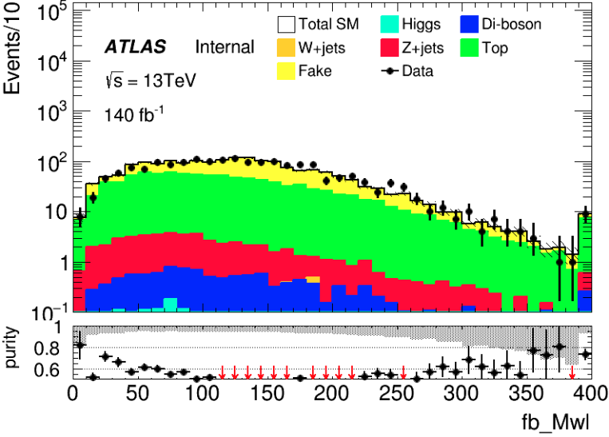
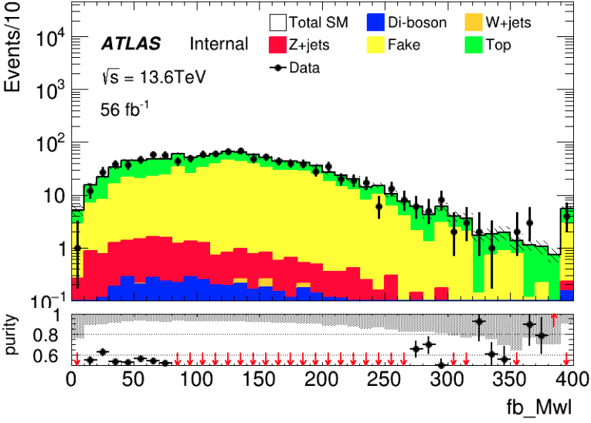
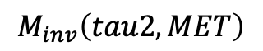
Distribution Check
HH TCR run2
HH TCR run3
$$M_{inv}\left(tau2, MET\right)$$

Slide 15
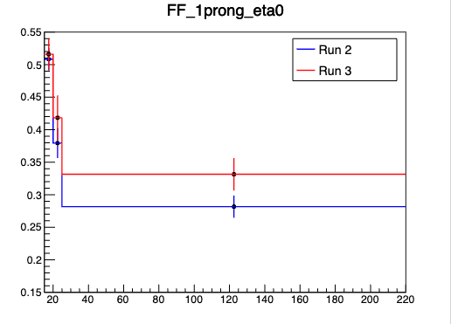
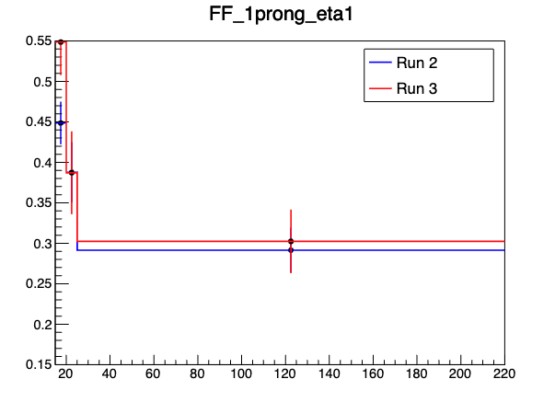
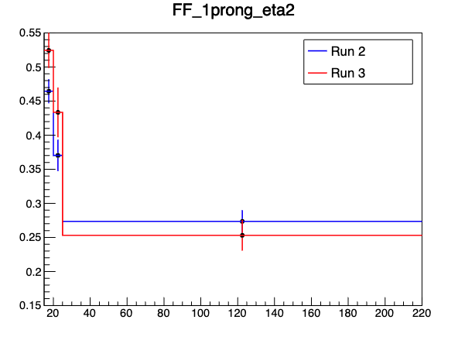
Cross-Check FF
$0<|η|<1$
$1<|η|<1.37$
$1.52<|η|<2.5$
My result
Wenyi’s result
Same value for first two bins and different in last bin for different rebin strategy I check FF with same rebin method in case, it turns out we are the same

Slide 16
Fake Factor for Run2 and Run3
$0<|η|<1$
$1<|η|<1.37$
$1.52<|η|<2.5$
Selection:
nBaseTau == 1
nBaseLep >= 1, SigLep >= 1 MET trigger, MET >= 200
Same-Signal(Orthogonal with SR) bVeto ID: nMediumTau == 1 antiID: nMediumTau < 1
A small bump show in the last bin

Slide 17
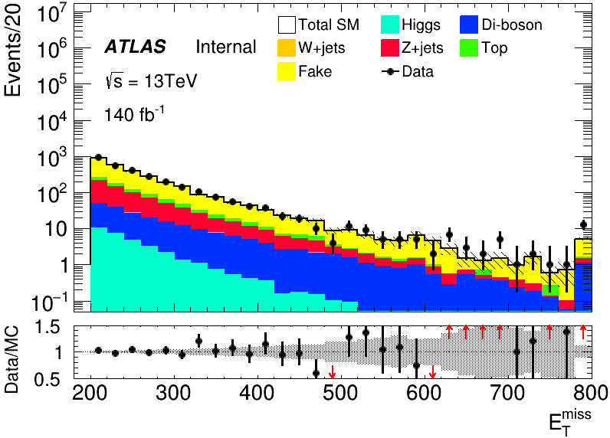
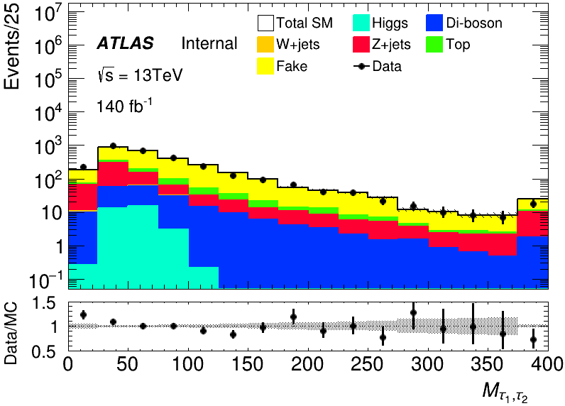
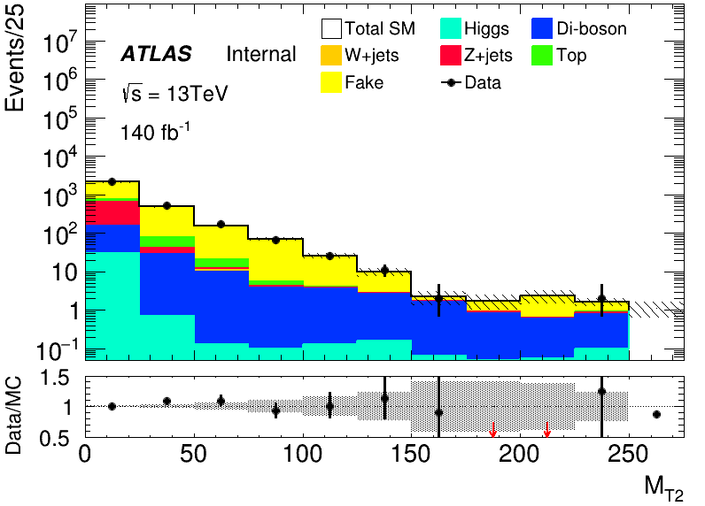
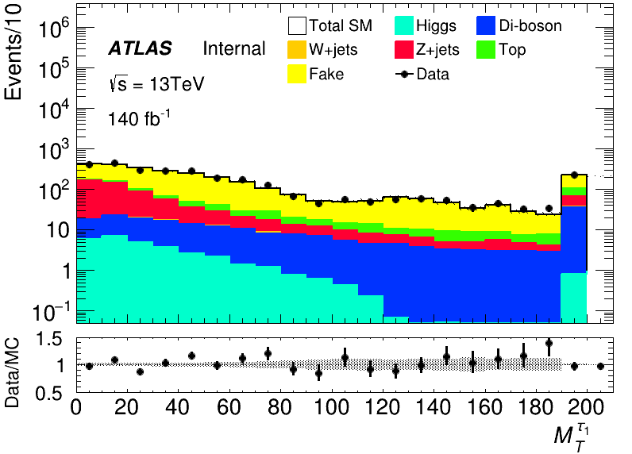
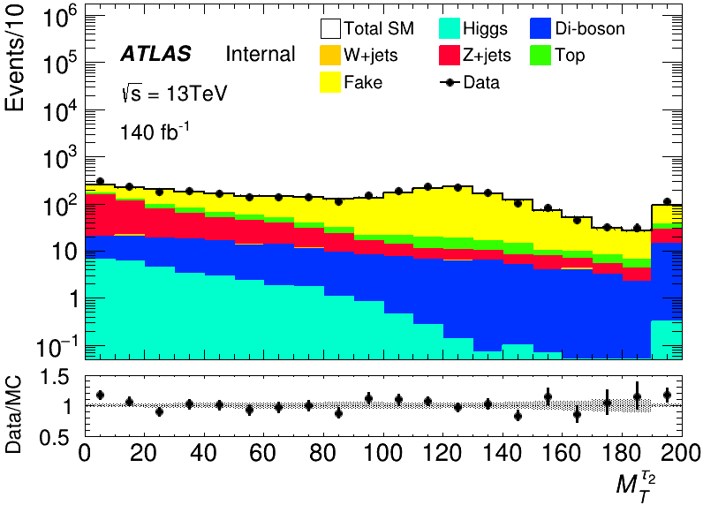
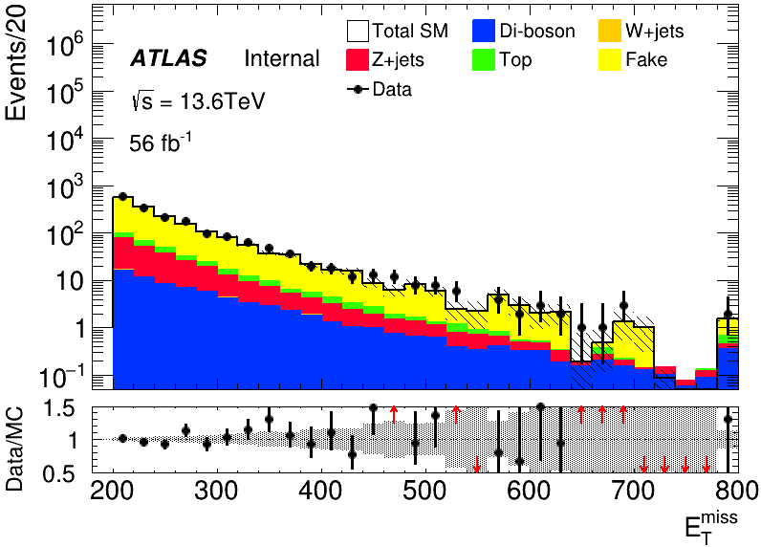
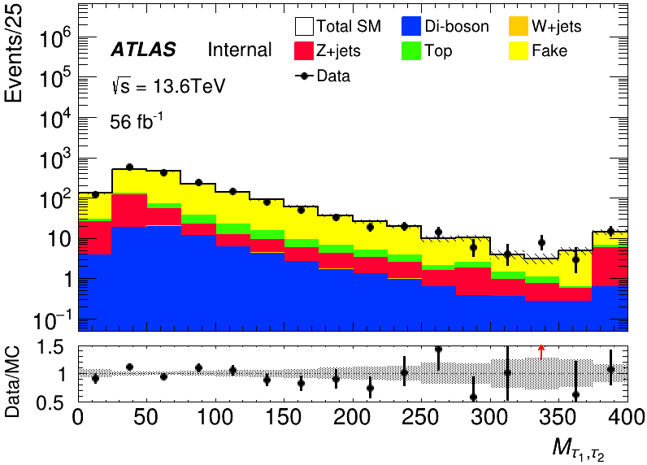
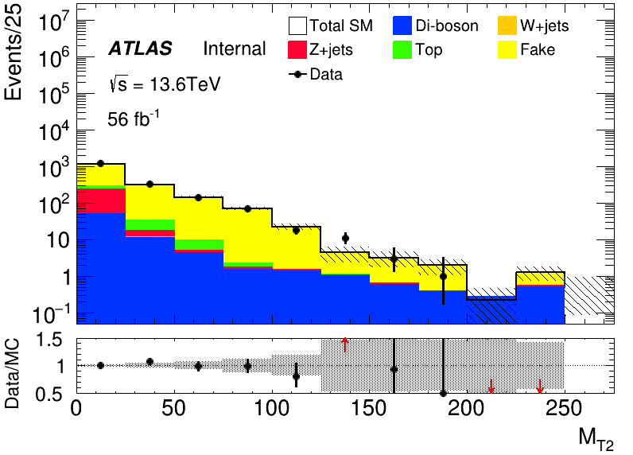
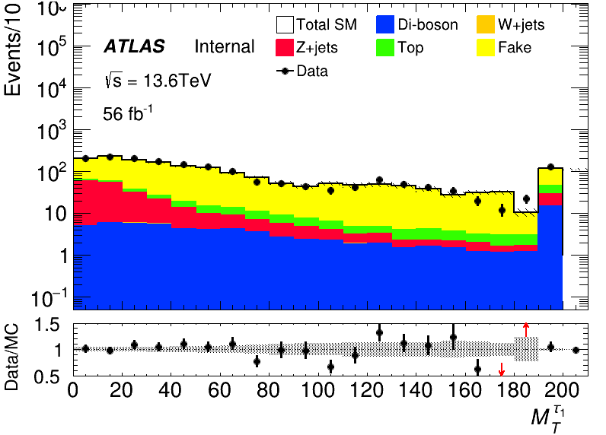
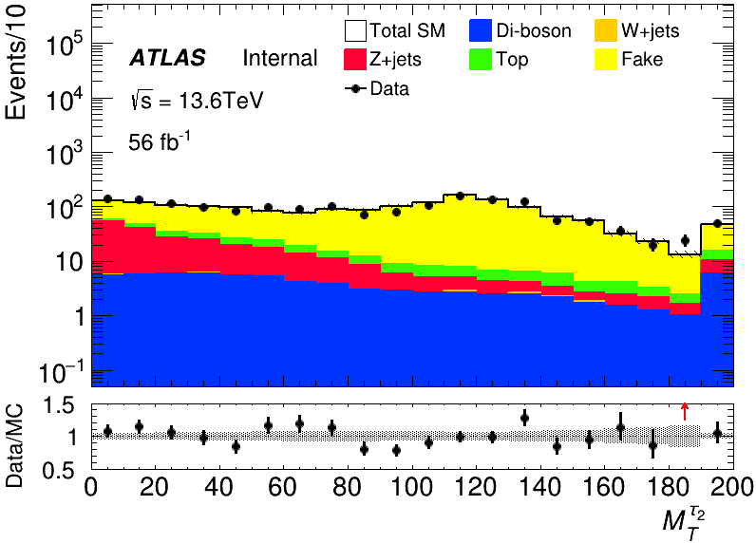
MC modeling in Pre-Selection(HH)
run2
run3

Slide 18
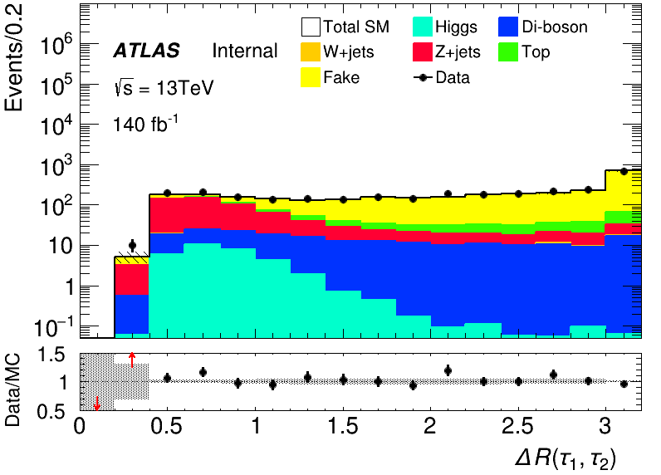







MC modeling in Pre-Selection(HH)
run2
run3

Slide 19






MC modeling in Pre-Selection(HH)
run2
run3

Slide 20










MC modeling in Pre-Selection(LH)
run2
run3

Slide 21








MC modeling in Pre-Selection(LH)
run2
run3

Slide 22






MC modeling in Pre-Selection(LH)
run2
run3

Slide 23
C1N2 SR(HH and LH)
Input sample:
bkg: run2 bkg sample passed pre-selection(HH/LH) sig: 100_70, 120_90, 140_90(only run2)
Hyperparameters: HH: Ntrees = 300, MaxDepth = 6, MinNodeSize = 1%, Learning rate = 0.05
LH: Ntrees = 200, MaxDepth = 6, MinNodeSize = 1%, Learning rate = 0.05
Weight choose: abs(physics weight)
Split strategy: Separate entries by using mod 5, for Fake bkg, if separate follow sequence, all weighted entry will split into first fold

Slide 24




BDT distribution for LH and HH
HH
LH
run2
run3

